Slide 1
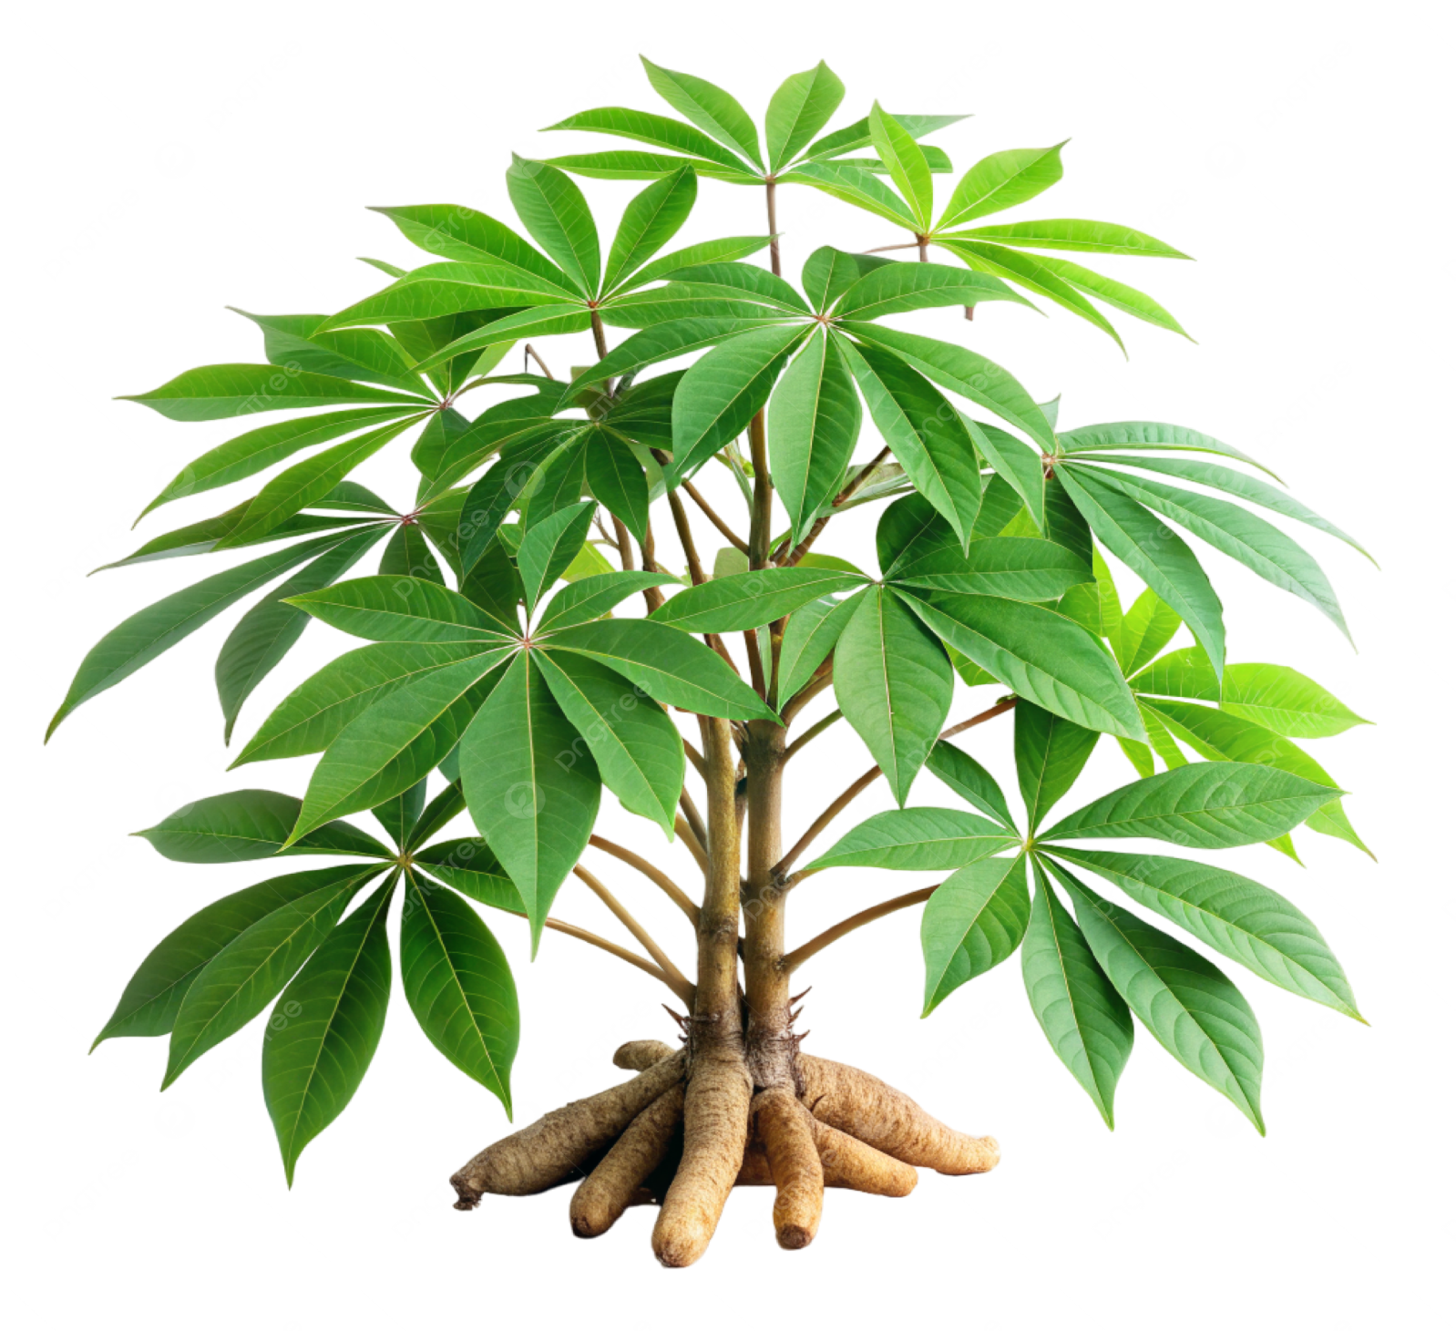
Disease detection in Crop Plant-’Cassava Plant’ Using Image Classification
Akshara Beena Sunil
23011489
MSc Data Science
University of Hertfordshire

Slide 2
Introduction
Overview of cassava plant and its importance
Common diseases affecting cassava plants
Early and accurate disease detection is essential for farmers to take preventive actions. This project applies deep learning techniques to automate this process.

Slide 3
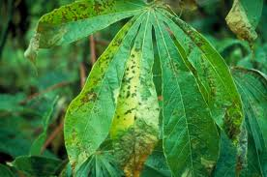
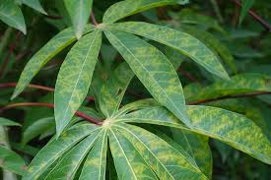
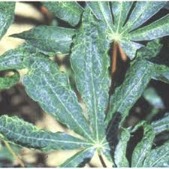
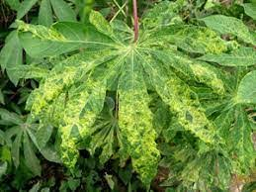
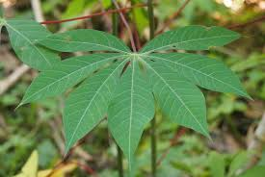
Problem Statement
Crop losses due to diseases like CMD, CBB, CBSD, and CGM
Challenges in manual disease detection
Importance of automation using machine learning
Bacterial Blight
Brown Streak
Green Mottle
Mosaic
Healthy

Slide 4
Research Question
How can machine learning techniques be applied to classify cassava plant diseases accurately?
What is the most effective model for this task?

Slide 5
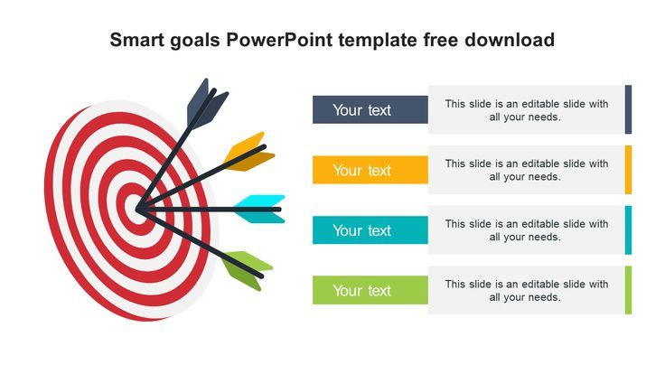
Aim and Objectives
Develop an automated classification system for cassava diseases
Preprocess and analyze dataset quality
Compare CNN models and transfer learning approaches (ResNet, EfficientNet, etc.)
Build a user-friendly system for disease detection
Evaluate model performance using precision, recall, and F1-score

Slide 6

Project Motivation & Importance
Why is this an important and useful topic?
How can farmers and agricultural experts benefit?
AI and Machine Learning offer a scalable and efficient solution

Slide 7
Dataset Description
Dataset Source: Kaggle –’Crop Diseases Classification Dataset‘
Link: https://www.kaggle.com/datasets/mexwell/crop-diseases-classification/data
orginally: ‘PlantVillage’, 54000 + photos, founded Hughes & Salathe
Classes:
Cassava Bacterial Blight (CBB)
Cassava Brown Streak Disease (CBSD)
Cassava Green Mottle (CGM)
Cassava Mosaic Disease (CMD)
Healthy
Contains labeled images and a CSV file mapping labels
Image format (.jpg, .png) & file size

Slide 8



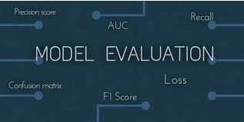
Methodology
Data Collection & Preprocessing
Model Selection & Traning
will experiment with
CNN
Transfer learnings (ResNET,EfficientNet) , to identify the best performing model
Load Cassava Datset
Clean & Preprocess images
Data Augumentation: technique to improve model generalization
System Development
Build a use interface for
Disease detection
Use precision, recall, F1-score
Analyze confusion matrix
Select best-performing model

Slide 9
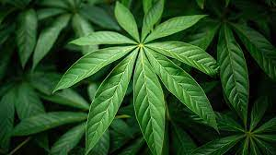
Expected Outcomes
A trained machine learning model for cassava disease classification
A simple user interface for farmers to upload images and detect diseases
Performance metrics: Accuracy, Precision, Recall, F1-score

Slide 10
Ethical Considerations
Dataset does not contain personal data (No GDPR concerns)
Ethical data collection from PlantVillage
Open-source dataset for educational and research purposes

Slide 11


Security & Data Storage
Regular backups on GitHub & OneDrive
Restricted access for staff and evaluators

Slide 12
Future Improvements
Collect more diverse data for better accuracy
Improve UI with real-time disease recommendations

Slide 13
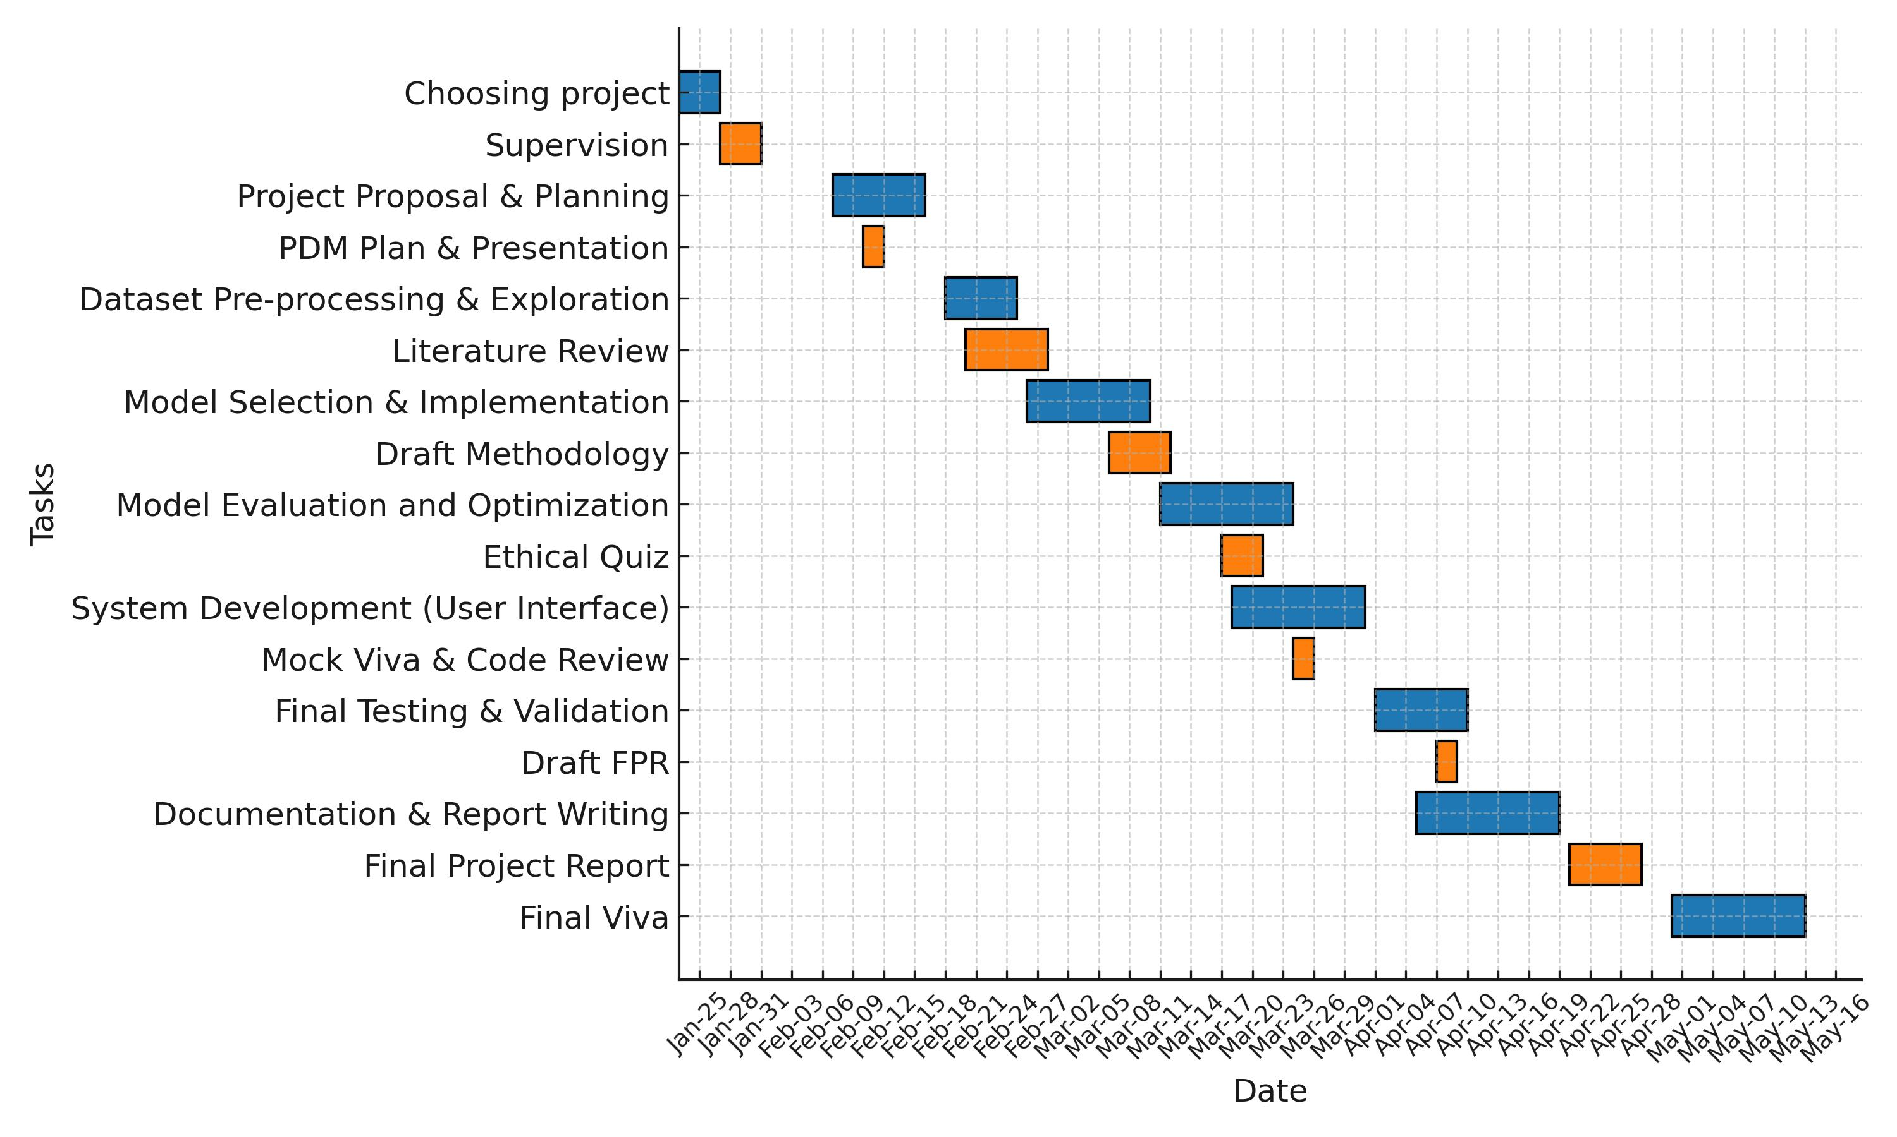
Gantt Chart

Slide 14
Relevant Links & Resources
GitHub Repository: https://github.com/Akshara-bs/Final-Project.git
Dataset Source: https://www.kaggle.com/datasets/mexwell/crop-diseases-classification/data
Orginally Generated from ‘PlantVillage’: https://www.tensorflow.org/datasets/catalog/plant_village
Research Papers & References
Ayu, H. R., Surtono, A., & Apriyanto, D. K. (2021). Deep Learning for Detection Cassava Leaf Disease. Journal of Physics: Conference Series, 1751(1), 012072.
Mwebaze, E., Gebru, T., Frome, A., Nsumba, S., & Tusubira, J. (2019). iCassava 2019 Fine-Grained Visual Categorization Challenge. arXiv preprint arXiv:1908.02900. https://arxiv.org/abs/1908.02900
Ramcharan, A., Baranowski, K., McCloskey, P., Ahmed, B., Legg, J., & Hughes, D. (2017). Deep Learning for Image-Based Cassava Disease Detection. Frontiers in Plant Science, 8, 1852. https://www.frontiersin.org/journals/plant-science/articles/10.3389/fpls.2017.01852/full

Slide 15
Conclusion & Next Steps
Current project status
Next immediate steps
Dataset Preprocessing & Exploration – Load, clean, and analyze the dataset
Literature Review – Study existing research on cassava disease detection
Model Selection & Implementation – Train CNN, ResNet, or EfficientNet models

Slide 16
Thank You

